Slide 1
UNIT-IV PART-I Topics to be covered
Study of RF Wireless Sensors
Wireless Network

Slide 2
Study of RF wireless sensors
Available On Demand
Works in perpetually dark locations
Works in hazardous locations
Provides Mobility
Provides Tracking capability
Can charge a secondary battery

Slide 3
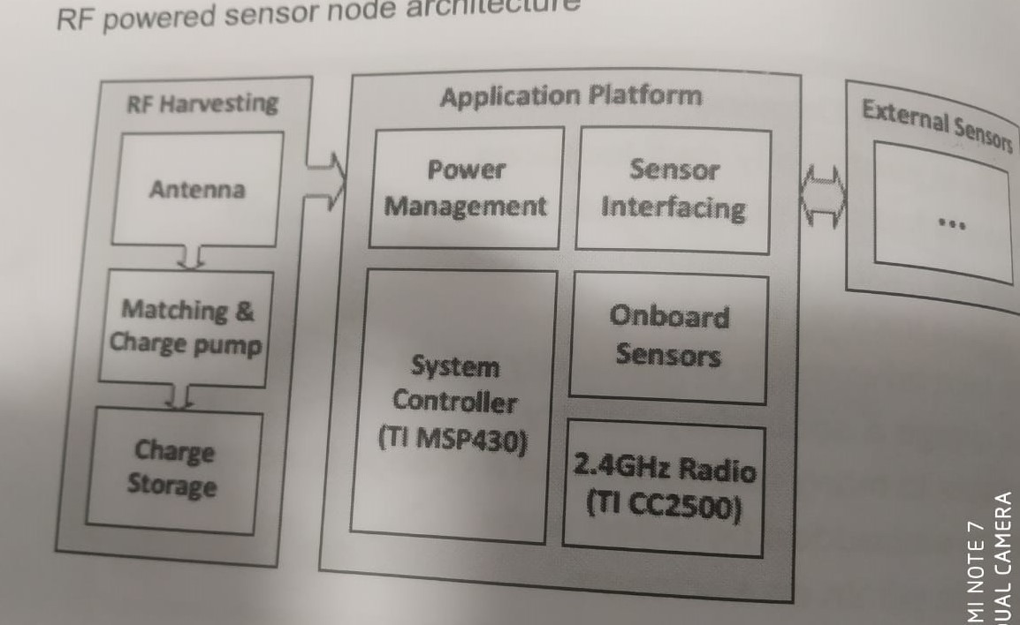
Study of RF wireless sensors cont..
RF powered sensor node architecture

Slide 4
Study of RF wireless sensors cont..
Different type of Sensors:
Capacitive Sensors
Current Sensors
Gas & Chemical Sensors
Hall Effect Sensors
Humidity Sensors
Inductive Sensors
Optical Sensors
Pressure Based Sensors
Temperature Sensors
Ultrasonic based sensors

Slide 5
Capacitive Sensors:
Capacitive proximity sensors are non-contact devices that can detect the presence or absence of virtually any object regardless of material. They utilize the electrical property of capacitance and the change of capacitance based on a change in the electrical field around the active face of the sensor.
Capacitive sensing technology is often used in other sensing technologies such as:
Flow
Pressure
liquid level
Spacing
Thickness
ice detection
accelerometers

Slide 6
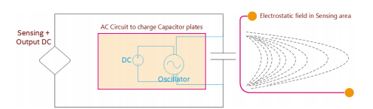

Slide 7
Capacitive Sensors cont..
Capacitive sensor dimensional measurement requires three basic components:
• a probe
• driver electronics
• a device

Slide 8
Capacitive Sensors cont..
Focusing the electric field
Guarding
Optimizing the Sensor
a. Effects of target size
b. Range of Measurement
c. Multiple channel sensing
d. Effects of target material

Slide 9
Capacitive Sensors cont..
Capacitive sensors can be very effective in measuring
• density,
• thickness, and
• location of nonconductors as well.

Slide 10
Capacitive Sensors Applications:
Position Sensing
Dynamic Motion
Thickness Measurement

Slide 11
Basic Components of Capacitance Sensing Technology
Driver-IC
The Sensor
Software

Slide 12
Current Sensor:
Current is fed to computers in which sensors convert it to proportional voltage.
Direct Sensing
Indirect Sensing

Slide 13
Current Sensor cont..
The current sensing resistor should have following attributes:
Low value in order to minimize power losses
Low inductance
Tight tolerance
Low temperature coefficient for accuracy
High peak power rating to handle short duration high current pulses.

Slide 14
Gas and Chemical Sensors
Gas sensors (also known as gas detectors) are electronic devices that detect and identify different types of gasses. They are commonly used to detect toxic or explosive gasses and measure gas concentration.
Chemical sensors are measurement devices that convert a chemical or physical property of a specific analyte into a measurable signal, whose magnitude is normally proportional to the concentration of the analyte.

Slide 15
Hall Effect Sensors
A Hall-effect sensor is a device to measure the magnitude of a magnetic field. Its output voltage is directly proportional to the magnetic field strength through it. Hall-effect sensors are used for proximity sensing, positioning, speed detection, and current sensing applications.

Slide 16
Humidity Sensors
A humidity sensor is a device that detects and measures water vapor. ... Based on our robust capacitive technology, these humidity sensors provide accurate measurement of dew point and absolute humidity by combining relative humidity (RH) and temperature (T) measurements.

Slide 17
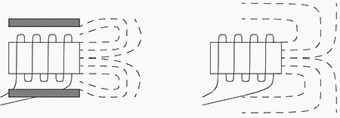
Inductive Sensors
An inductive sensor is a device that uses the principle of electromagnetic induction to detect or measure objects. An inductor develops a magnetic field when a current flows through it; alternatively, a current will flow through a circuit containing an inductor when the magnetic field through it changes.
Shielded and Un-shielded Sensors

Slide 18
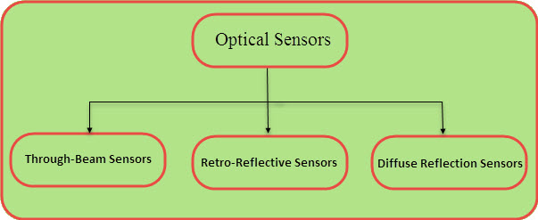
Optical Sensors
An optical sensor converts light rays into electronic signals. It measures the physical quantity of light and then translates it into a form that is readable by an instrument. An optical sensor is generally part of a larger system that integrates a source of light, a measuring device and the optical sensor.
Types of Optical Sensors:

Slide 19
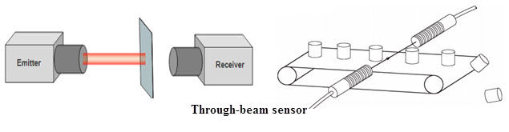
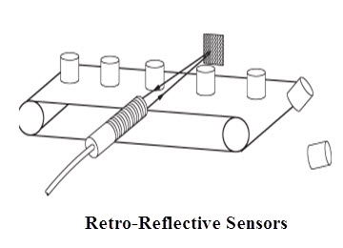
Optical Sensors

Slide 20
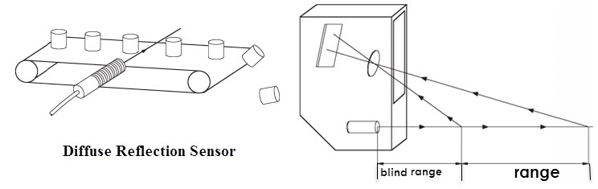
Optical Sensors

Slide 21
Pressure Sensors
A pressure sensor is a device for pressure measurement of gases or liquids. Pressure is an expression of the force required to stop a fluid from expanding, and is usually stated in terms of force per unit area. A pressure sensor usually acts as a transducer; it generates a signal as a function of the pressure imposed.
Type of Pressure Measurement
Absolute
Gauge
Differential

Slide 22
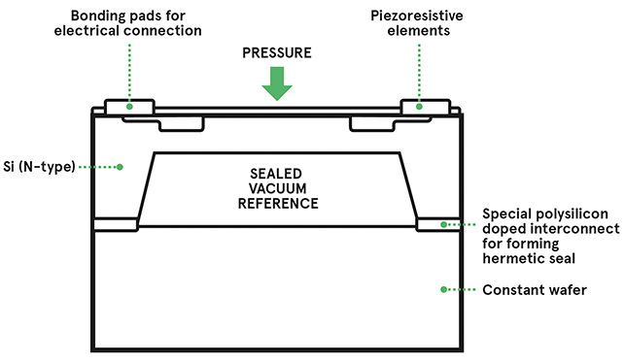
Pressure Sensors
Absolute

Slide 23
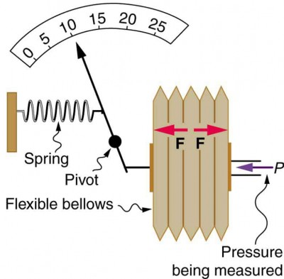
Pressure Sensors
Gauge

Slide 24
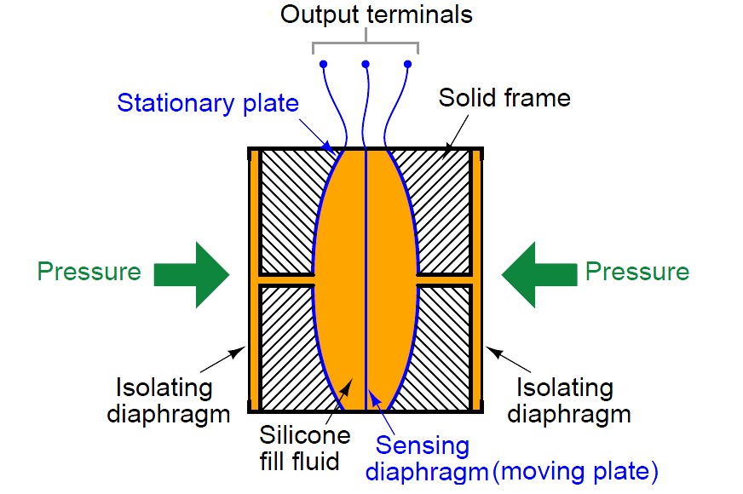
Pressure Sensors
Differential

Slide 25
Temperature Sensors
A temperature sensor is an electronic device that measures the temperature of its environment and converts the input data into electronic data to record, monitor, or signal temperature changes. There are many different types of temperature sensors.

Slide 26
Ultrasonic Sensors
An ultrasonic sensor is an electronic device that measures the distance of a target object by emitting ultrasonic sound waves, and converts the reflected sound into an electrical signal. Ultrasonic waves travel faster than the speed of audible sound (i.e. the sound that humans can hear).

Slide 27
Wireless Networks and its types:
Computer networks that are not connected by cables are called wireless networks. They generally use radio waves for communication between the network nodes. They allow devices to be connected to the network while roaming around within the network coverage.
Types:
1. Bluetooth and BLE
2. Zigbee Protocols
3. Wi-Fi
4. Satellite Communication
5. RFID

Slide 28
1. Bluetooth and BLE
Attacks In Bluetooth enable devices:
BLUEJACKING
BLUEBUG Attack
Car Whisperer
SNARF Attack
BACKDOOR Attack

Slide 29
2. Zigbee Protocols
Zigbee specifications:
Zigbee PRO
Zigbee RF4CE
Zigbee IP

Slide 30
3. Wi-Fi
Wired Equivalent Privacy (WEP)
Wi-Fi Protected Access (WPA)
Wi-Fi Protected Access version 2 (WPA2)

Slide 31
4. Satellite Communication
LEO, GEO, and ATG Satellites

Slide 32
5. RFID
Radio Frequency Identification (RFID) uses radio waves to transmit small amounts of data from an RFID tag to a reader within a very short distance.

Slide 33
Computer Connect to Internet
Network Devices
Hubs
Switches
Routers
Gateways
Firewalls

Slide 34
Device Configuration and Management Hubs
M2M device management
Exchange Information without Human Intervention Routers
Quicker Processing and More accurate Delivery

